Slide 1

Hospitality
Joey Gurak & Sam D’Antonio
Notes:
Sam & Joey

Slide 2
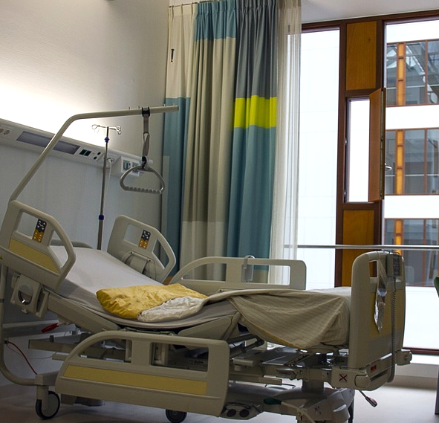
What is Hospitality?
A website & app service
Connects hospital patients with
available companions
Companions provide:
  Friendly ear
  Moral support
  Basic entertainment
  Personalized attention
Notes:
Sam
Dictionary.com defines “hospitality” as “the friendly reception and treatment of guests or strangers.” We use our brand name as a sort of play on words, meeting the medical aspect of a hospital with the friendly nature of our service.

Slide 3
Brand Positioning Statement
Hospitality is an app and website service
that keeps the daily life of hospital patients
and their loved ones in mind.
We connect patients to our companions,
focusing on our philosophy of
giving patients a mental boost.
Notes:
Sam
Hospitals can be frightening places, especially if your family and friends aren't able to be there with you.

Slide 4
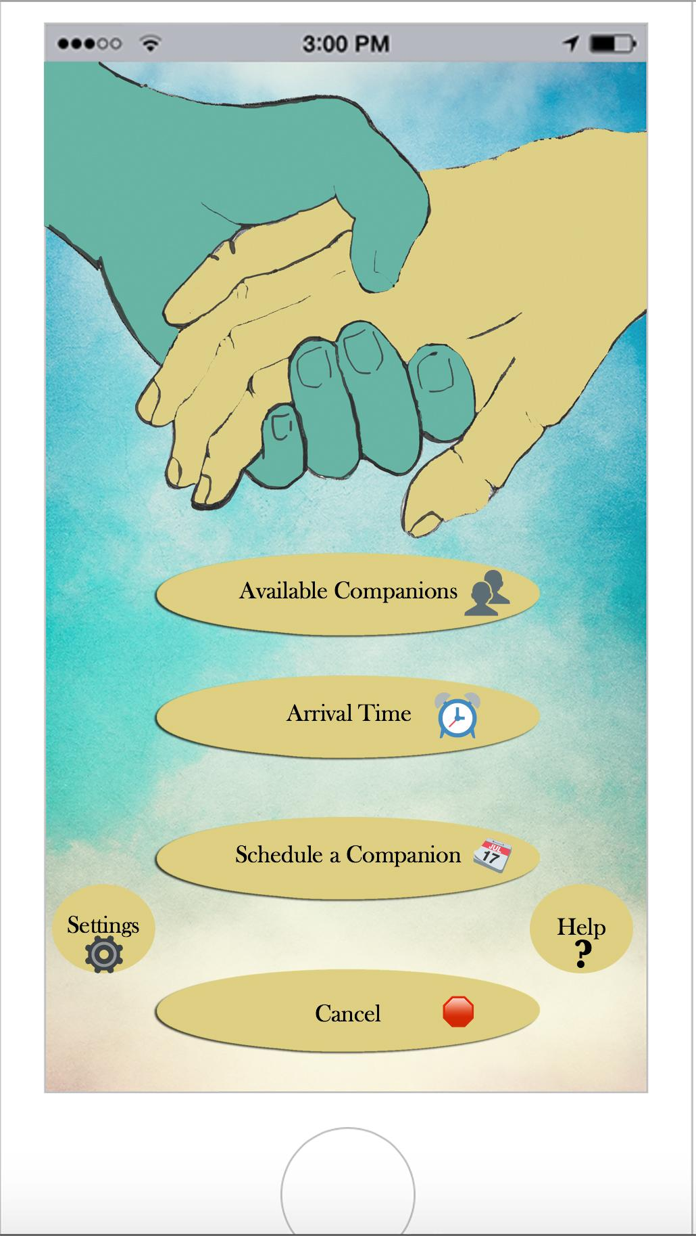
Our App
Notes:
Joey

Slide 5
We emphasize the importance of the mind-body connection.
Notes:
Sam

Slide 6

What is the mind-body connection?
Speeding recovery from illness
Lessening pain and discomfort
Shortening hospital stays
Increasing mental alertness
From the Michigan Psychological Association
Notes:
Sam
We base our service on the principle that a healthy mind results in a healthy body. Studies have found that improved psychological health results in an improved recovery time.
https://www.michiganpsychologicalassociation.org/mindbody_health_connection.php

Slide 7

Primary Research
90%
$10/hr
Survey with 75 respondents
desire companionship
best price point
Notes:
Joey

Slide 8
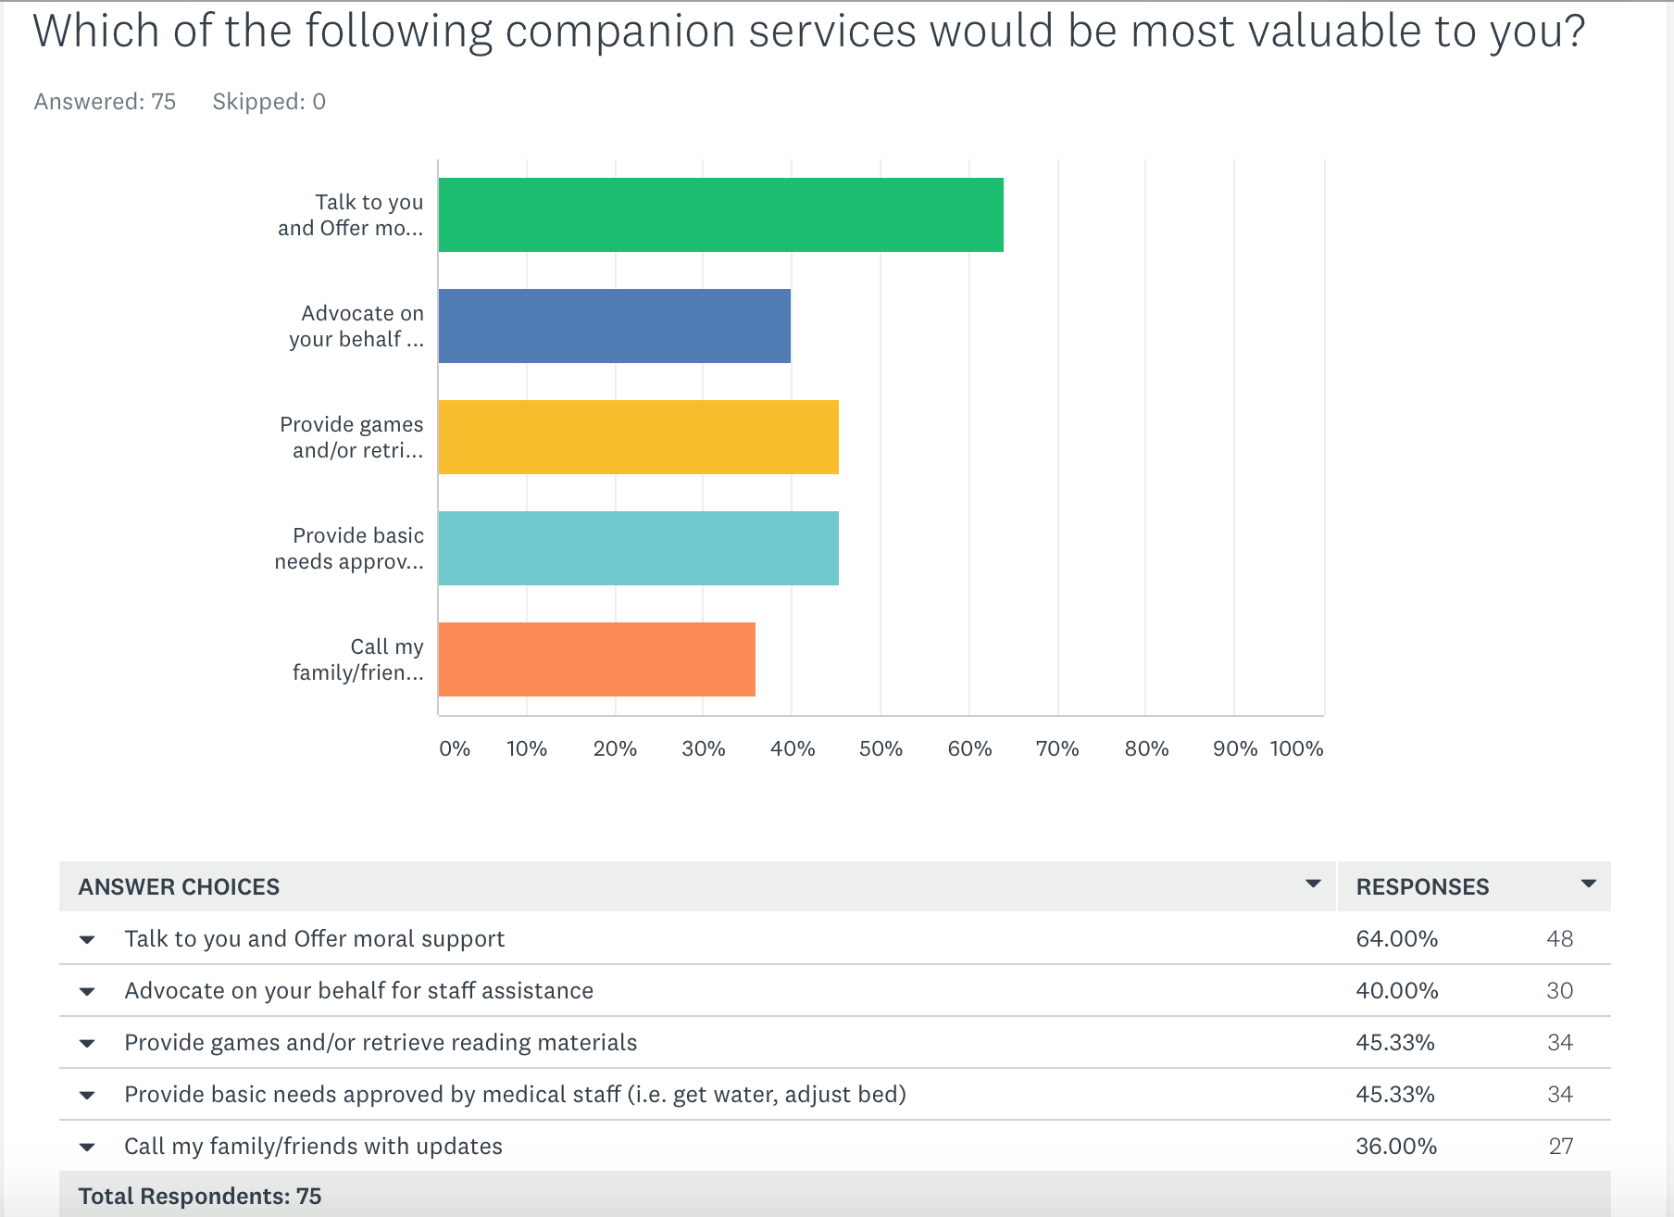
Notes:
Joey
Above all other services, people want moral support. As humans, we crave meaningful interactions, and we see these as valuable aspects of wellness.

Slide 9
The Competition
Bedside, by Tanooki Labs
Mobile-friendly website
Coordinates hospital visits
Updates & messages loved ones
Free account
JeffConnect
Jefferson Hospital app
Virtual ER visit
Via smartphone or computer with webcam
$49 per visit
Notes:
Sam
These two services are both a source of competition in the web realm. Bedside offers a web-based hospital communication tool, coordinating hospital visits easily with loved ones. JeffConnect is an app unique to Jefferson Hospital, offering the potential for virtual ER visits for “non-life-threatening illnesses.”

Slide 10

More Competition
Patient Sitter
Monitors behavior and health
Patient transport
Reports to staff
Particular patients
Notes:
Joey
Patient Sitter is offered not through apps but rather through hospitals. This service is limited to particular patients only, and the “Patient Sitter” reports back to hospital staff. This service is primarily medical.

Slide 11
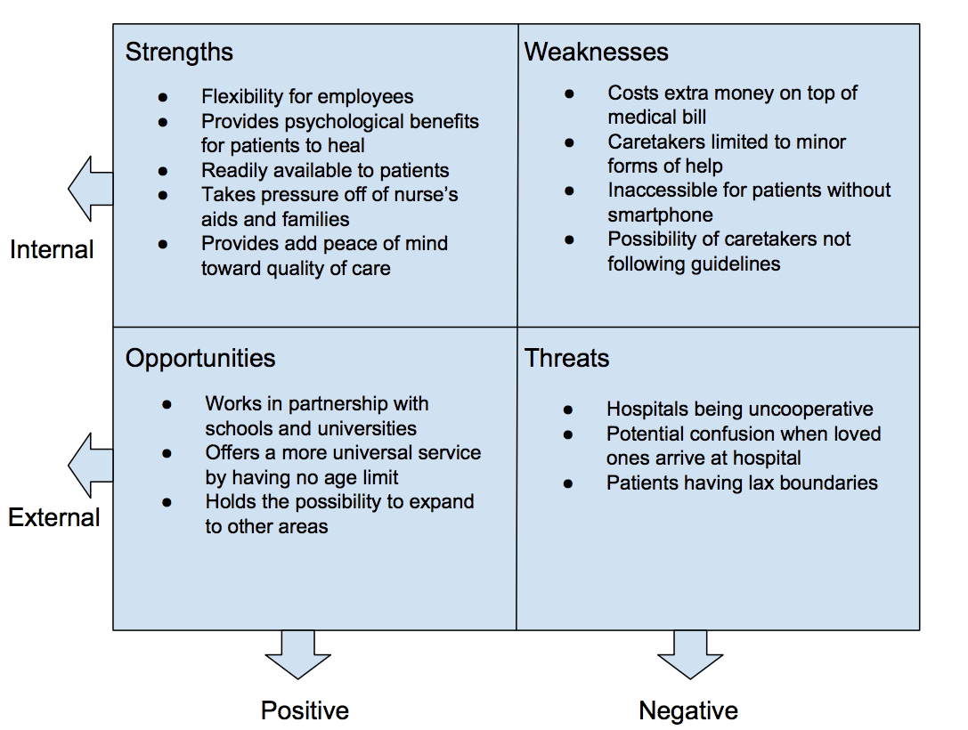
SWOT
Notes:
Joey & Sam
Because of our distinct service, we have a great chance for strengths and opportunities. [discuss them]
But venturing into a new realm is never problem-free. [discuss weaknesses & threats, but be sure to offer a positive mindset and solutions]

Slide 12
Our target demographic
25-55 year olds in the Greater Philadelphia Area
Members of the workforce
Middle to upper-middle class
Have loved ones to take care of
Psychographics
  Thinkers
  Achievers
  Believers
Notes:
Sam

Slide 13

Persona:
Anna Estevez-Martino
Medford, NJ
42 years old
Married to Bob for 15 years
Mother of 2
  12 year old son
  10 year old daughter with special needs
Only child of single mother
Notes:
Joey
Anna is a 42 year old mother of two who lives in Medford NJ.
She has been married to her husband, Bob for 15 years.
She has a 12 year old son and an 10 year old daughter with special needs.
Anna had to cut her full time job in medical billing to three days a week at the office and one day working from home because her children needed her.
Bob works full time as an events coordinator and travels so is not home part of the week leaving her to take care of all family duties.
Anna is an only child.
Anna’s mother Silvia is 66, divorced and lives alone. She has to been having issues with her back and is planning to have surgery. The surgeon says she will be in the hospital for about three to four days and about a week in rehab.
Anna knows her mother has some friends who will visit but most of the family live in upstate New York and are unlikely to come down.
Ann would not call herself conservative but was raised Catholic and has traditional values like putting family ahead of everything else. The idea that her mother might be alone scares her but she has to be there for the kids and keep her job.

Slide 14
What We
Don’t Do
Provide medical assistance
Provide messaging with loved ones
Plan visits with loved ones
Notes:
Sam

Slide 15
What We
Do
Offer moral support via companion-
ship
Relieve burdens for patients & families
Encourage mental improve-
ments
Notes:
Joey

Slide 16
Our Objectives
Notes:
Sam

Slide 17
1.0: Obtain news coverage from 3 local stations in 6 months
1.1. Position Hospitality as a helpful, fresh service
  1.1.1. Send media kits introducing Hospitality
  1.1.2. Teddy Bear Care guerrilla campaign
1.2. Establish Hospitality as a service unlike any other
  1.2.1. Send news releases to local stations & newspapers
  1.2.2. Create short informative video on YouTube Channel
Notes:
Joey

Slide 18
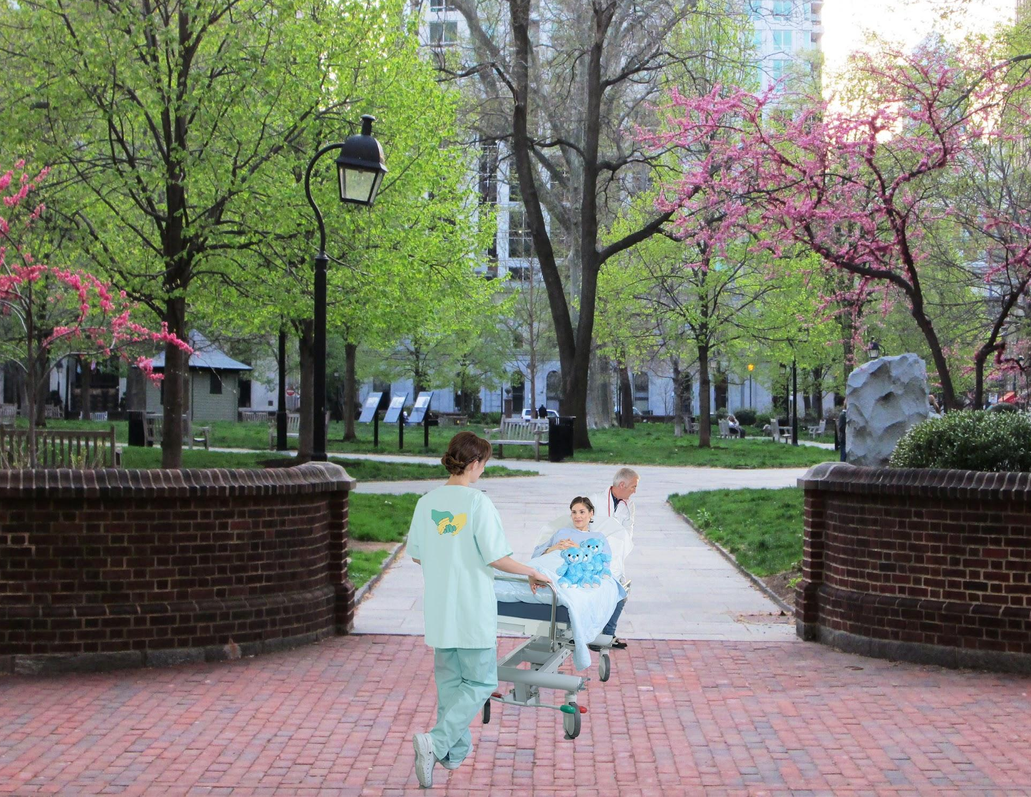
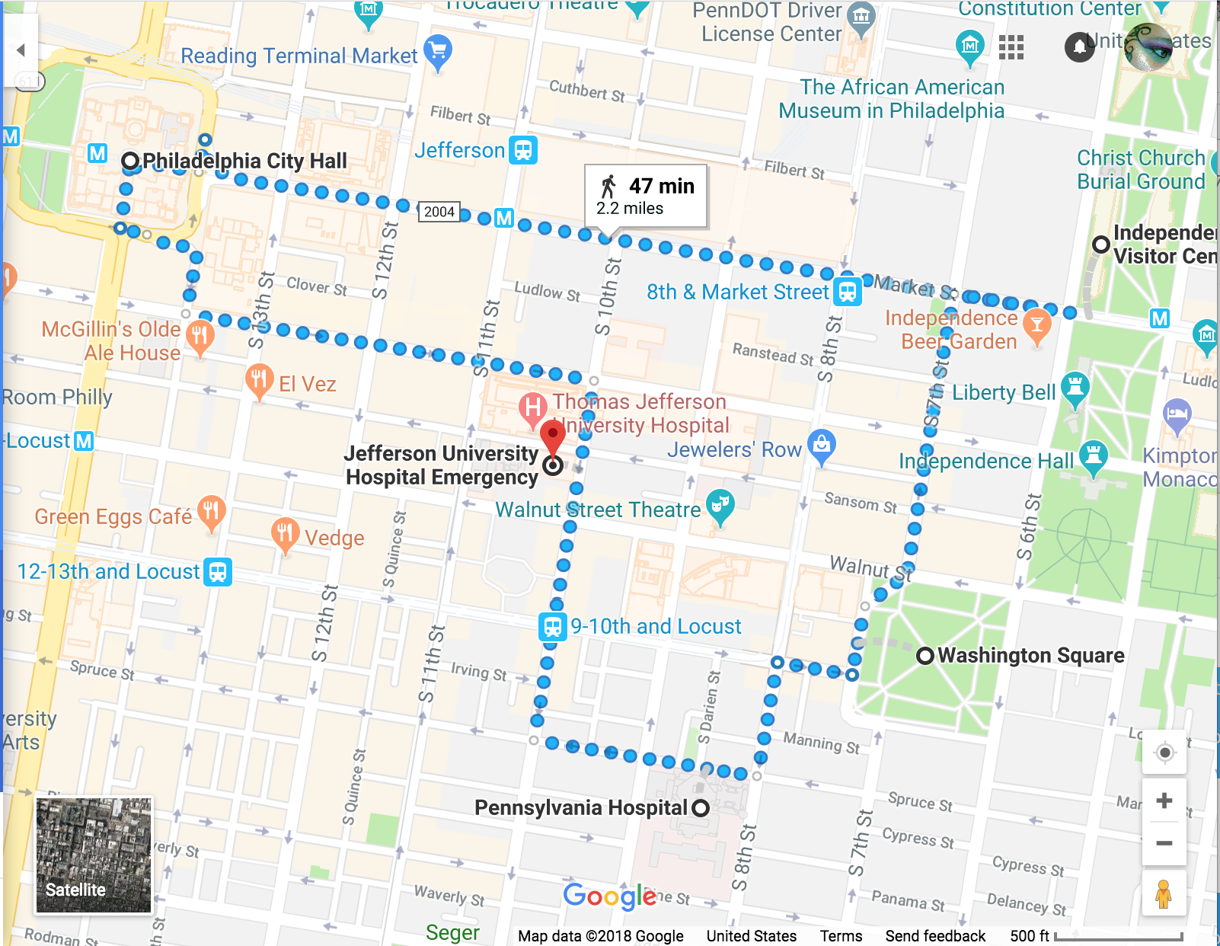
Guerrilla Tactic:
Teddy Bear Care
Notes:
Joey

Slide 19
2.0: Gain 7,500 regional users in 9 months
2.1. Appeal to busy audience who needs an easy solution during hospital stays
  2.1.1. Transit ads on SEPTA & Patco
  2.1.2. Digital ads on Facebook and Instagram
  2.1.3. Brand ambassadors’ testimonials
2.2. Establish our brand as a useful, cost-efficient service
  2.2.1. Offer coupons to save money on first session
  2.2.2. Distribute pamphlets in medical centers
Notes:
Sam

Slide 20
3.0. Expand service to 25 hospitals in the tri-state area within 1 year
3.1. Generate interest by appealing to audience’s need for a helping hand
  3.1.1. Word-of-mouth through brand ambassadors
  3.1.2. Feature stories talking about how Hospitality helped customers
3.2. Create demand by showing usefulness of service
  3.2.1. Use testimonials in our advertisements
  3.2.2. Create & post content about the mind-body connection
Notes:
Joey

Slide 21
Media plan
Transit ads
$200,000
9 months
Traditional media
Local magazines
$300,000
6 months
Notes:
Sam

Slide 22




Media plan
Non-
traditional media
Paid Online
Ads
$100,000
Owned
Social media
$50,000
Notes:
Sam
When it comes to the non-traditional media we will have paid online ads such as banners, AdSense, Sponsored tweets, Email advertising, On YouTube and Facebook ads just name a few. We will also have Facebook, Instagram, Pinterest and YouTube accounts as well as a Blog along with our website and app that will be managed by ourselves and a dedicated social media contributor.

Slide 23
Budget: $1M
Program | Price
Guerrilla campaign | $50,000
Transit Advertising | $200,000
Social Media Marketing | $50,000
Brand Ambassadors | $150,000
Informative Promo Video | $75,000
Online Advertising | $100,000
Promotional/ Press Kits | $50,000
Print Advertising | $300,000
Notes:
Joey
Transportation advertisements
$4,500 for 30 Interior Display (Vertical Format): Range of $75 - $150 per ad per 4 week period on Patco and Regional Rail
Guerrilla Campaign
3 modified hospital beds with vinyl decals
Estimate $5,0000, $2,850 for 500 teddy bears in logo t-shirts $2664 for 600 Hanes tagless

Slide 24
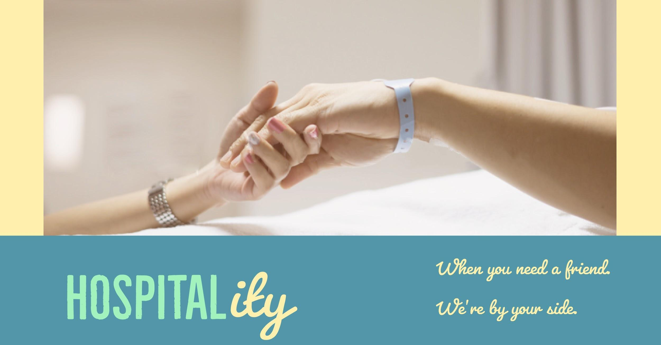
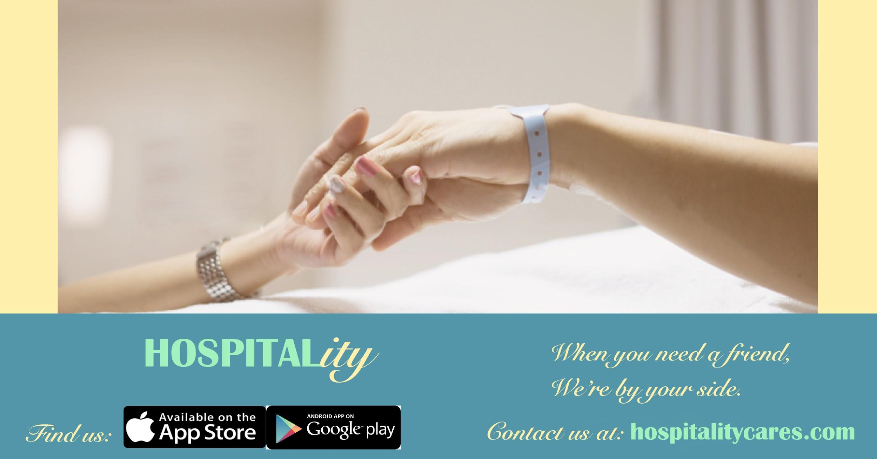
1.
TRANSITION HEADLINE
Let’s start with the first set of slides
Notes:
Joey

Slide 25
“Love and caring are critical tools for helping patients get better.
If it were a form of medication,
we would prescribe it.”
Ronnie Nathan, Chief Barker of the Variety Club Children’s Charity
Notes:
Sam

Slide 26
Thank you for your time!
Any questions?
?
Notes:
Joey & Sam

Slide 27
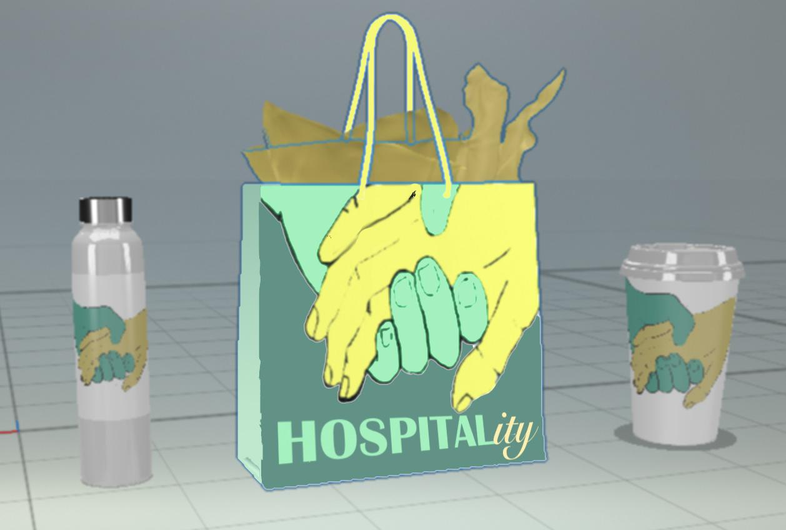
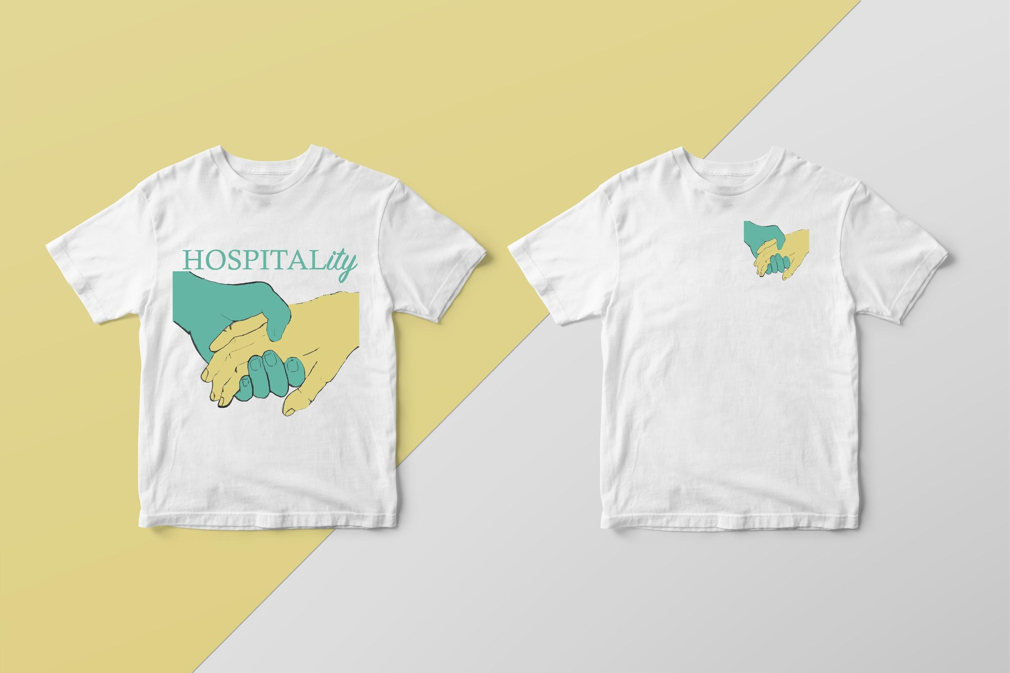
Check out our
pre-launch website at
https://spark.adobe.com/page/m5sDYnYIHGzeA/

