Slide 1
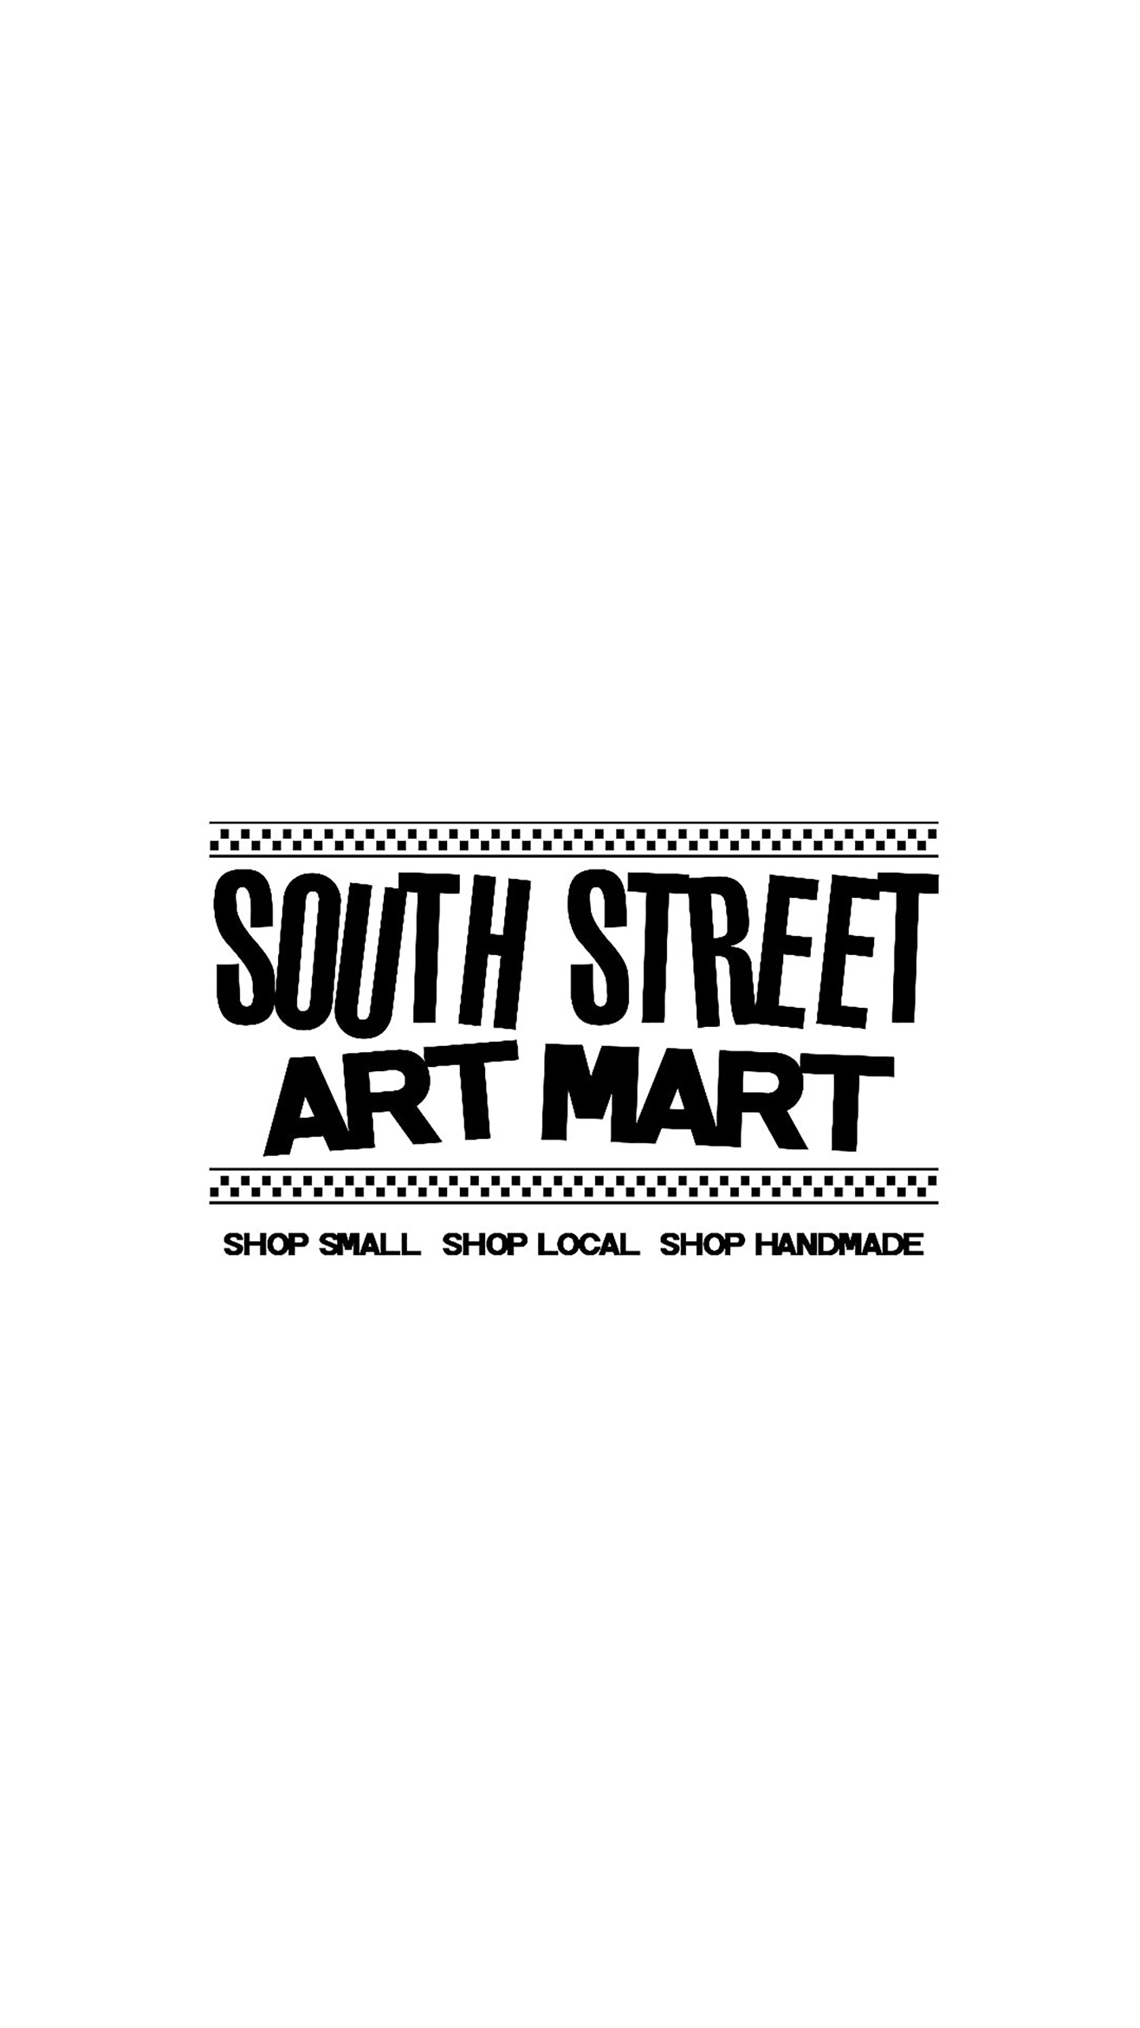

Practical Solutions
South Street Art Mart
Joey Gurak

Slide 2
To inform local Philly Residents that South Street Art Mart sells unique handmade, artistic, locally designed, fun and funky clothes, jewelry, pet and home goods.
Goals:
Low cost promotion to increase awareness and sales
Increase social media influence
Promote interest in store
Inform of move to new location

Slide 3
Strengths Unique handmade art Supports local artist Distinctive takes on pop culture themes Great Location Growing social presence | Weaknesses Not intended to be a permanent store Many artist also have Etsy stores Dependant on individual artists Expensive location
Opportunities Gives customers a first hand experience with the art unlike online Opens the “buy local” movement Increases notoriety to local artist who in turn can help the store | Threats Artist may pull out if their pieces do not sell Locals and tourists may not see a need for handmade pop culture Cost of rent and paying the artist may make turning a profit impossible

Slide 4

New Location Campaign
Press Release to Philadelphia Magazine
Flyers to be distributed at the Spring Festival & Pride Day
Thank you Greeting cards sent out to 101 Go Fund Me donors to maintain customer loyalty
Engaging Social Media post informing of New Location
                Create New Location GIF

Slide 5
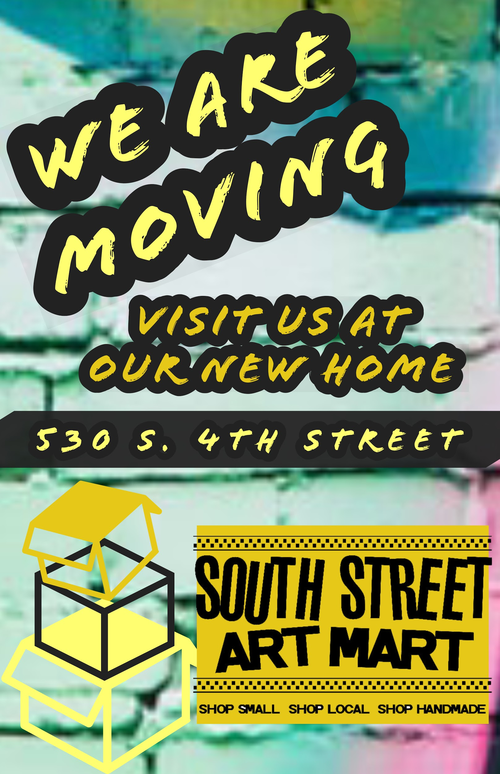
Window poster promoting
Their NEW location

Slide 6
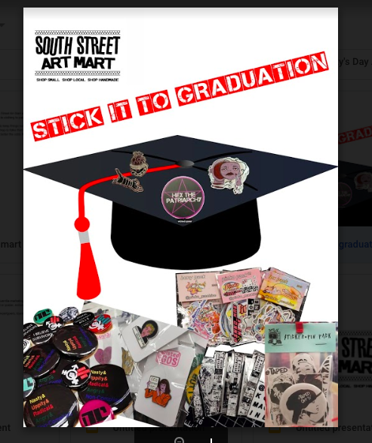
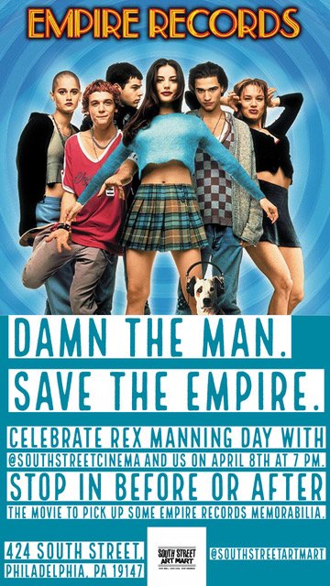
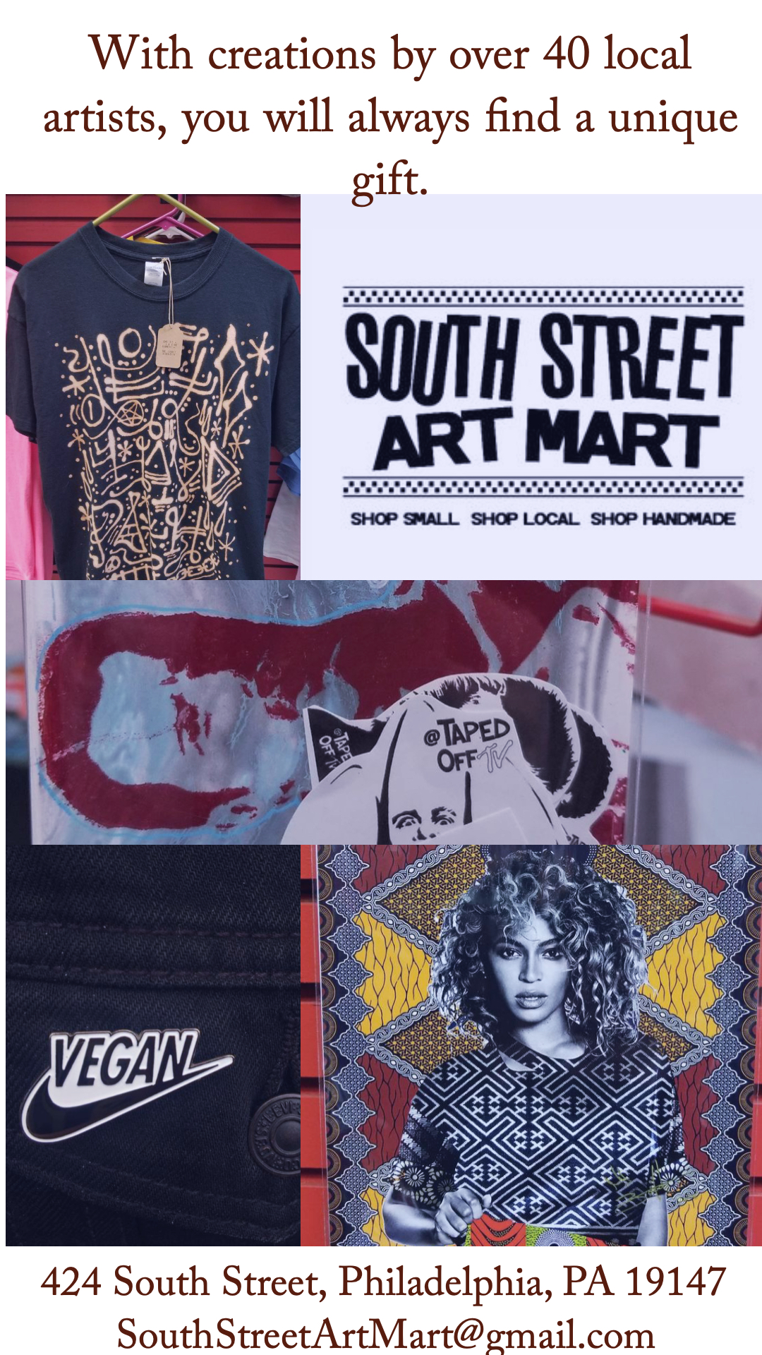
Ads for Instagram

Slide 7
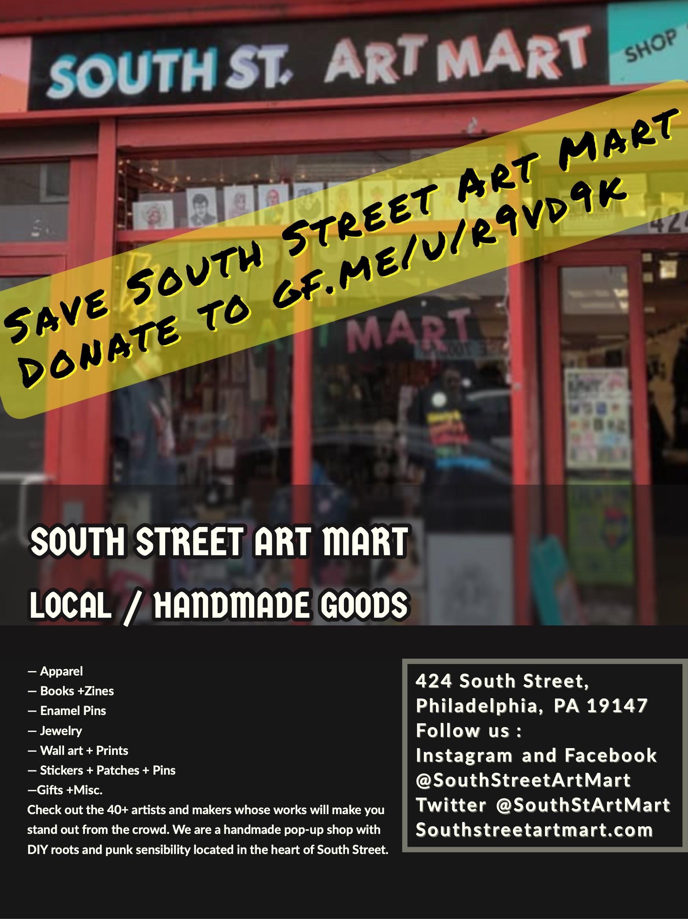
Informing about Go Fund Me

Slide 8
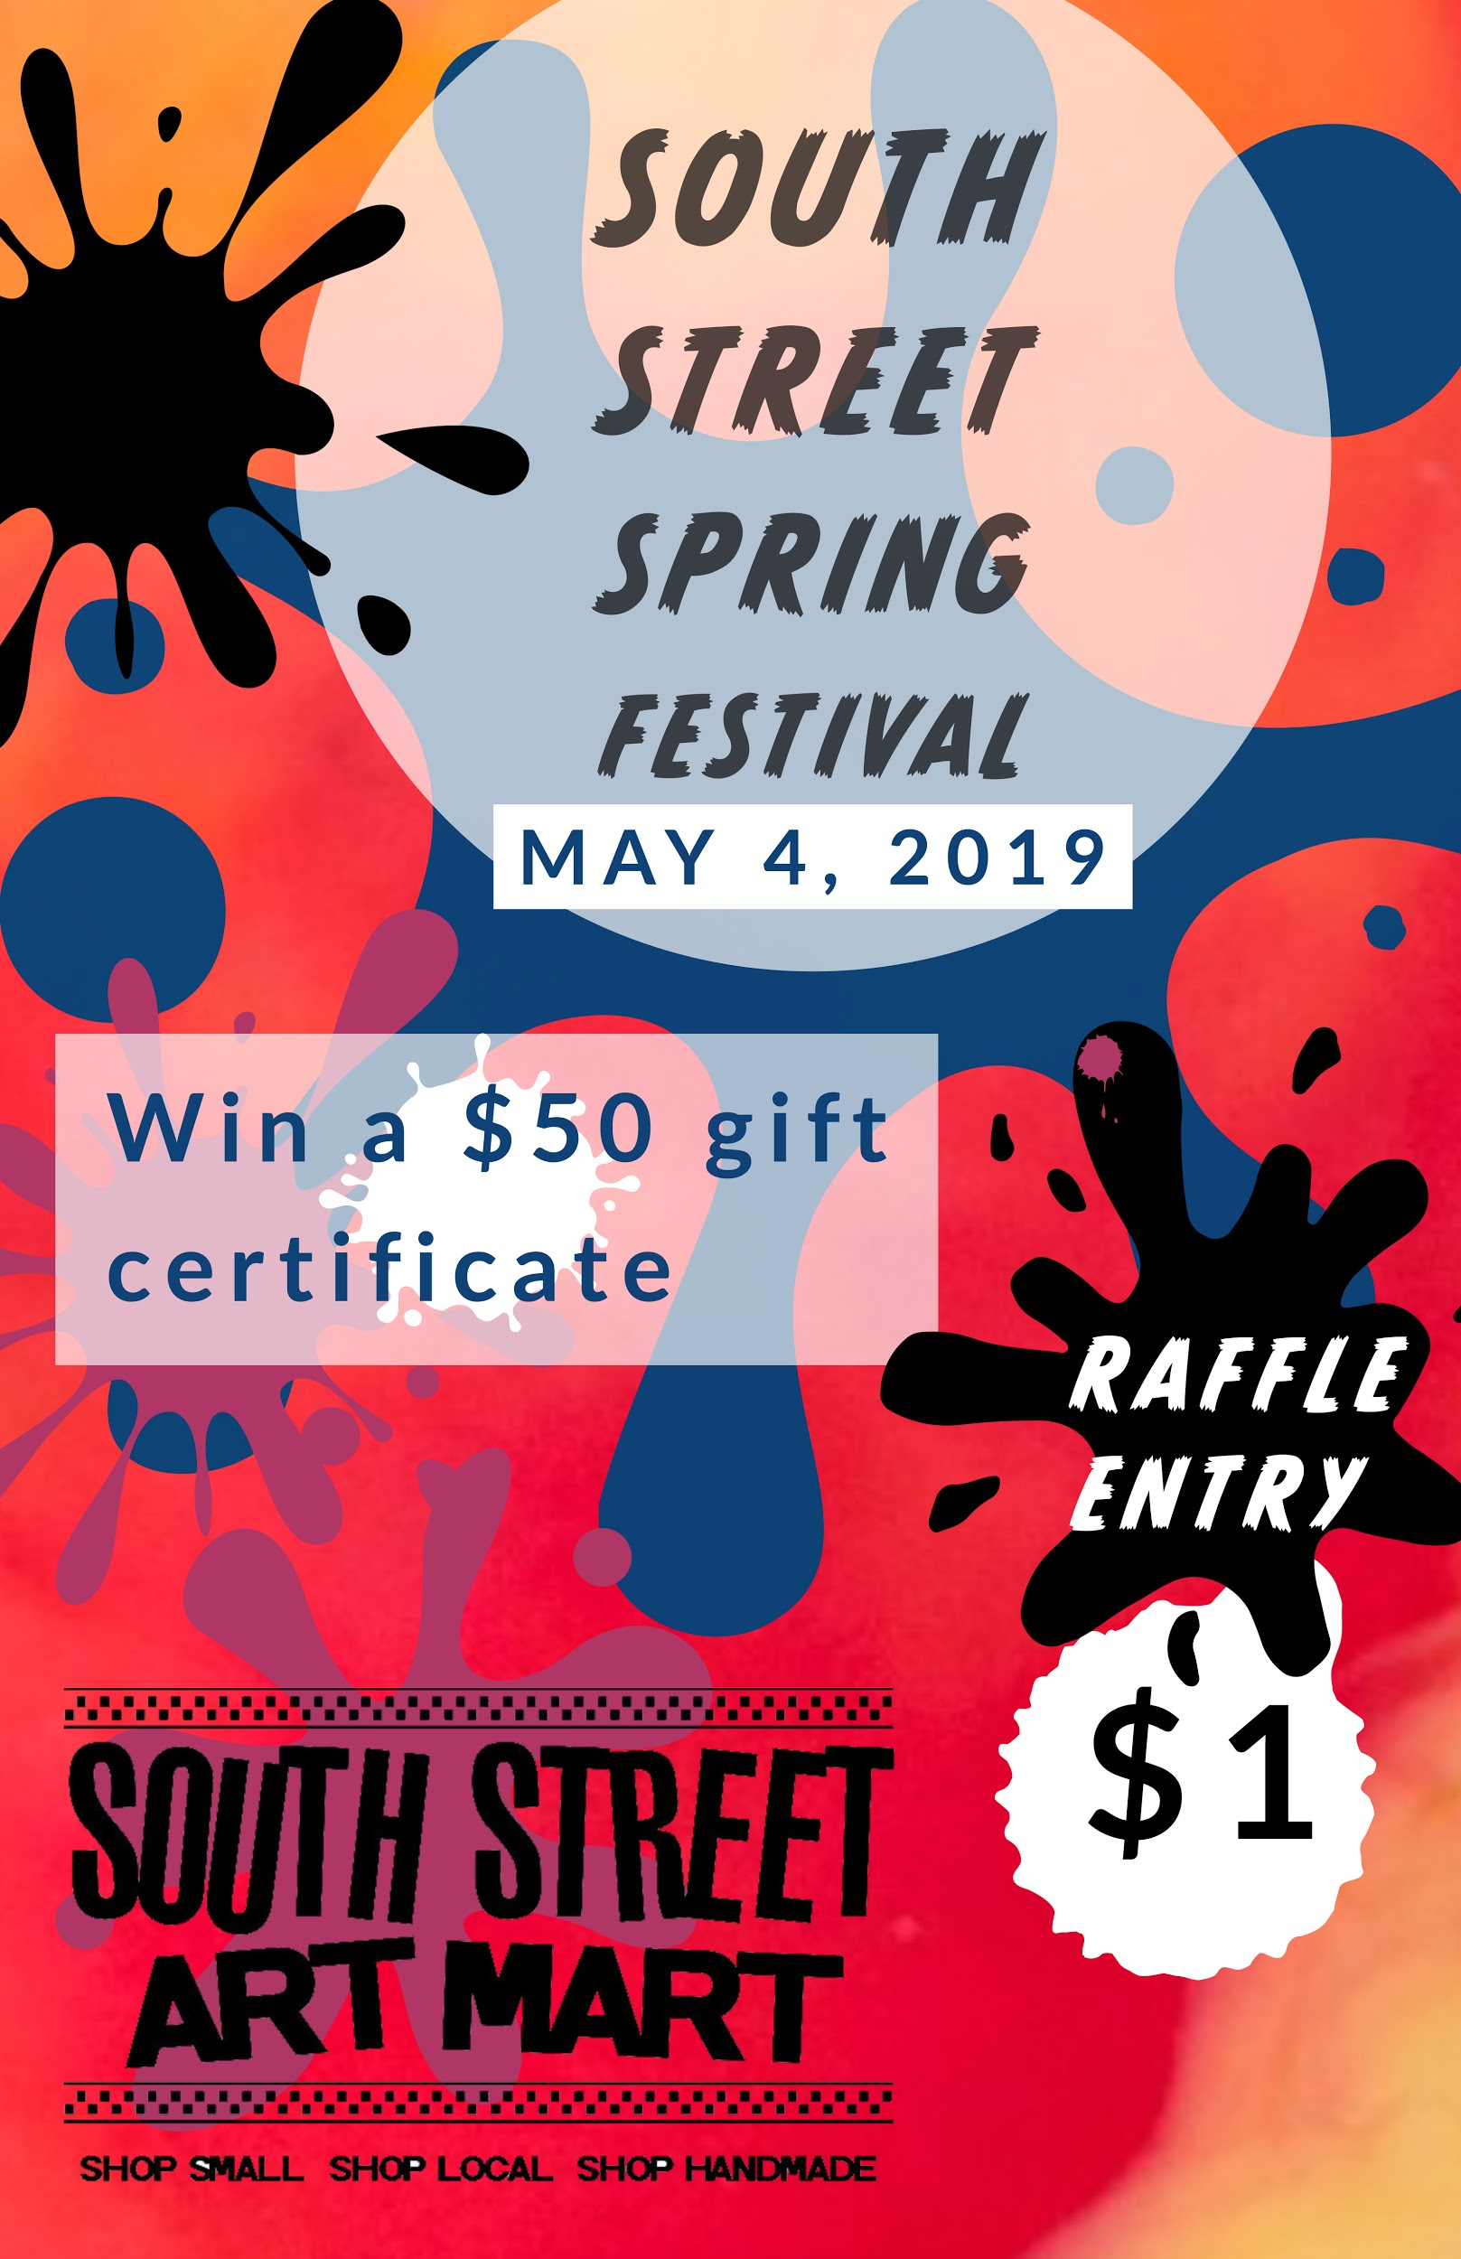
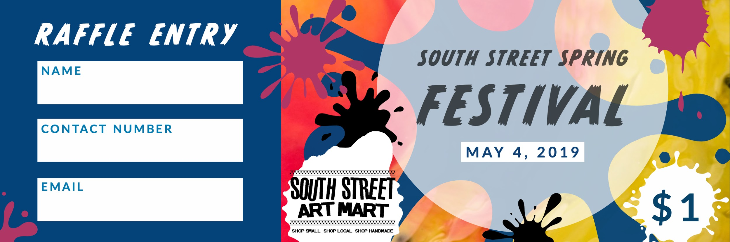
Spring Fest Raffle

Slide 9
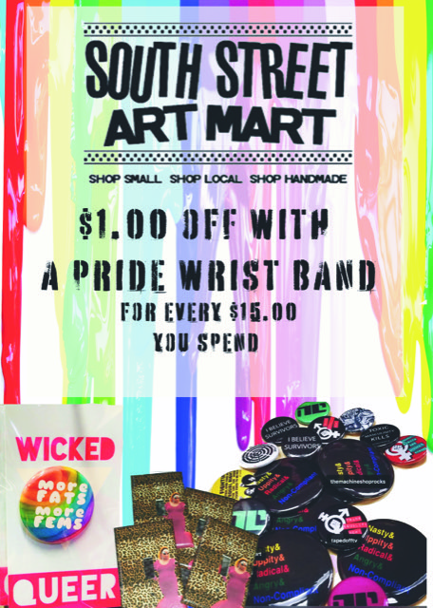
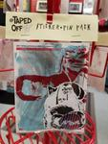
Pride Promotions
Having a Rep at pride handing out bags with
Stickers and pins promoting the store
and LGBT+ icons.

Slide 10

Podcast Ad
Client:South Street Art Mart
Title:Meet SSAM
Length: 30sec
Writer: Practical Solutions
Medium: Podcast
When I am looking for presents for my friend's generic gifts just won't cut it. That is why I am so happy that I found the South Street Art Mart.
They have unique, handmade gifts with a punk sensibility that stand out from the ordinary.
When you stop in tell (Podcast) sent you for $1.00 off any purchase of $15.00.
Check out their new location at 530 S. 4th Street, Philly, visit their website @ https://southstreetartmart.com/ , or check them out them on social media.
South Street Art Mart.

Slide 11
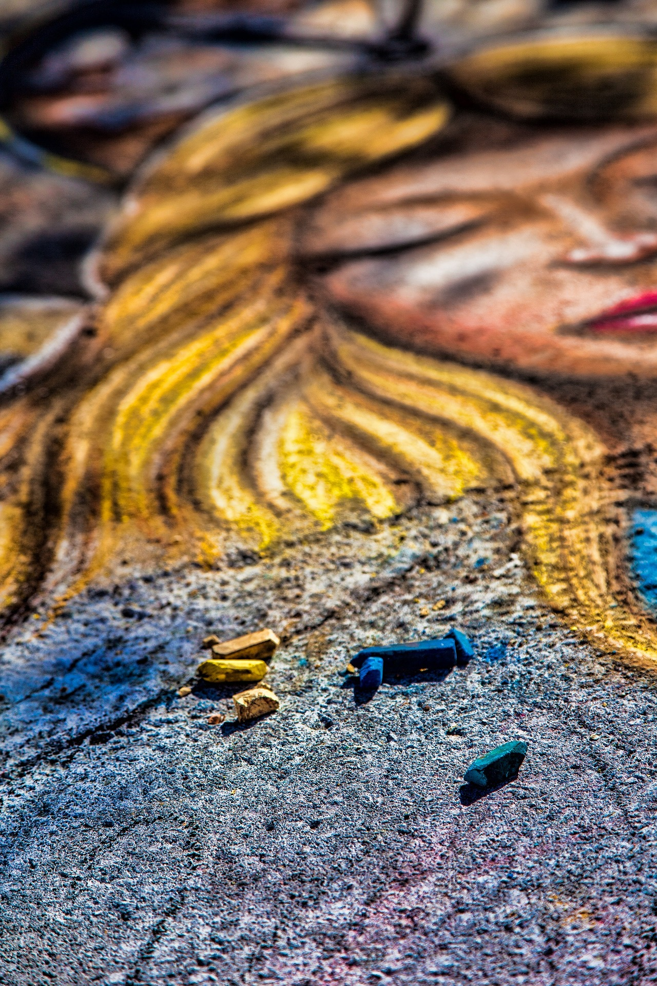
Chalk The Street
To promote interest local artist will create street art using chalk
in front of the store.

Slide 12
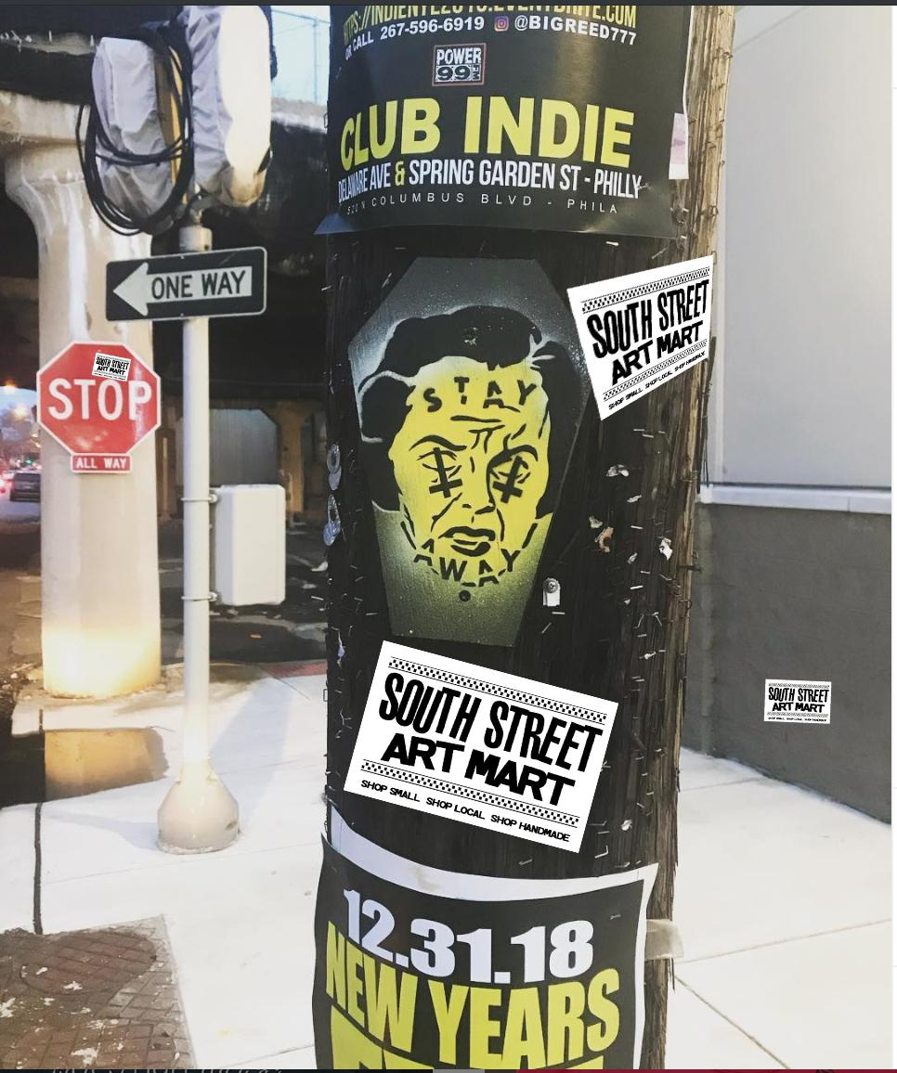
And that Punk Classic, Stickers

